Slide 1
ECE314 Lab 2 Overview
Histogram
Law of Large Numbers
Simulation of simple games
Poker hands
The Monty Hall problem

Slide 2







Histogram
You toss a dice 1000 times. Results: 220 1s, 180 2s, 100 3s, 150 4s, 150 5s, 200 6s
#
$$1000$$
$$1$$
$$2$$
$$3$$
$$4$$
$$5$$
$$6$$

Slide 3
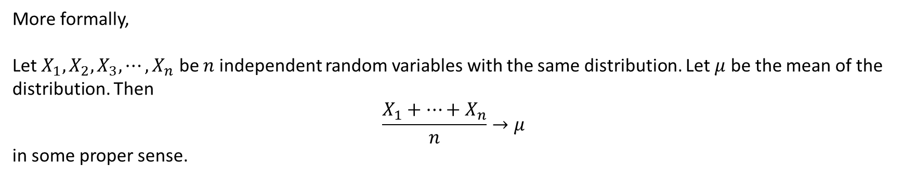
Law of Large Numbers
Q: If you toss a fair dice 1,000,000 times and calculate the average value, what do you expect this value to be like?
A: Close to 3.5
More formally,
Let $X_{1}, X_{2},X_{3}, ⋯, X_{n}$ be $n$ independent random variables with the same distribution. Let $μ$ be the mean of the distribution. Then
$$\frac{X_{1}+⋯+X_{n}}{n}→μ$$
in some proper sense.

Slide 4
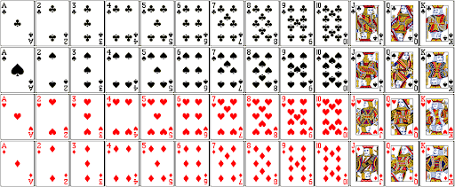
Poker hands
If you random draw five cards, Pr(flush) = ?

Slide 5

The Monty Hall Problem
There are three doors. Behind one door there is a goat, behind the other two doors there is nothing.

Slide 6
The Monty Hall Problem
There are three doors. Behind one door there is a goat, behind the other two doors there is nothing.
You choose one door.

Slide 7
The Monty Hall Problem
There are three doors. Behind one door there is a goat, behind the other two doors there is nothing.
You choose one door.
Suppose this is the door you choose.

Slide 8

The Monty Hall Problem
Empty
There are three doors. Behind one door there is a goat, behind the other two doors there is nothing.
You choose one door.
Suppose this is the door you choose.
The host, who knows which door has the goat, reveals one empty door to you.

Slide 9
The Monty Hall Problem
Empty
There are three doors. Behind one door there is a goat, behind the other two doors there is nothing.
You choose one door.
Suppose this is the door you choose.
The host, who knows which door has the goat, reveals one empty door to you.
You now have two choices: 1. stick with your original choice, 2. switch to the other door remained.

Slide 10
The Monty Hall Problem
Empty
There are three doors. Behind one door there is a goat, behind the other two doors there is nothing.
You choose one door.
Suppose this is the door you choose.
The host, who knows which door has the goat, reveals one empty door to you.
You now have two choices: 1. stick with your original choice, 2. switch to the other door remained.
Q: Should you switch?

